Slide 1
DOCUMENTATION

Slide 2
KNOWHERE
Website for retrieving missing/misplaced/lost items, pet animals and children.

Slide 3
AIM:
KNOWHERE wants to spread our message of hope and compassion. We believe that a single action can make a difference in the community, and that collective action can greatly impact the world. Through advocacy and outreach activities, our team works tirelessly each day to contribute their part to the greater good.
We help you by retrieving for you what you have misplaced/lost as quickly as possible.

Slide 4
Overview Of HTML:
HTML stands for Hypertext Markup Language, and it is the most widely used language to write Web Pages.
Hypertext refers to the way in which Web pages (HTML documents) are linked together. Thus, the link available on a webpage is called Hypertext.
As its name suggests, HTML is a Markup Language which means you use HTML to simply "mark-up" a text document with tags that tell a Web browser how to structure it to display.
Originally, HTML was developed with the intent of defining the structure of documents like headings, paragraphs, lists, and so forth to facilitate the sharing of scientific information between researchers.
Now, HTML is being widely used to format web pages with the help of different tags available in HTML language.

Slide 5
Basic HTML Document:
<!doctype html>
<html>
<head>
<title>This is a document</title>
</head>
<body>
<h1>This is a heading</h1>
<p> Document content goes here…</p>
</body>
</html>

Slide 6
Synopsis:
Using input from the user, KNOWHERE team tracks the lost items and returns it to the respectful owners along with help from other users.
Sharing stories on our social made pages and contributing for our donation programme will increase our efficiency.
We, the lost and found team sincerely and tirelessly will do our best to help you.

Slide 7
Requirements:
Hardware:-
Computer/PC/Laptop
Internet
External hard drive/DVD for backup
Software:-
Notepad

Slide 8
SOURCE CODES:
A text listing of commands to be compiled or assembled into an executable computer program.

Slide 9
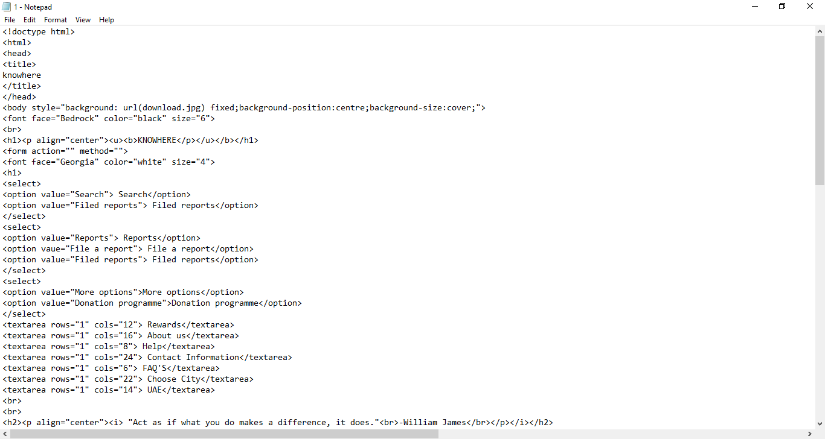

Slide 10
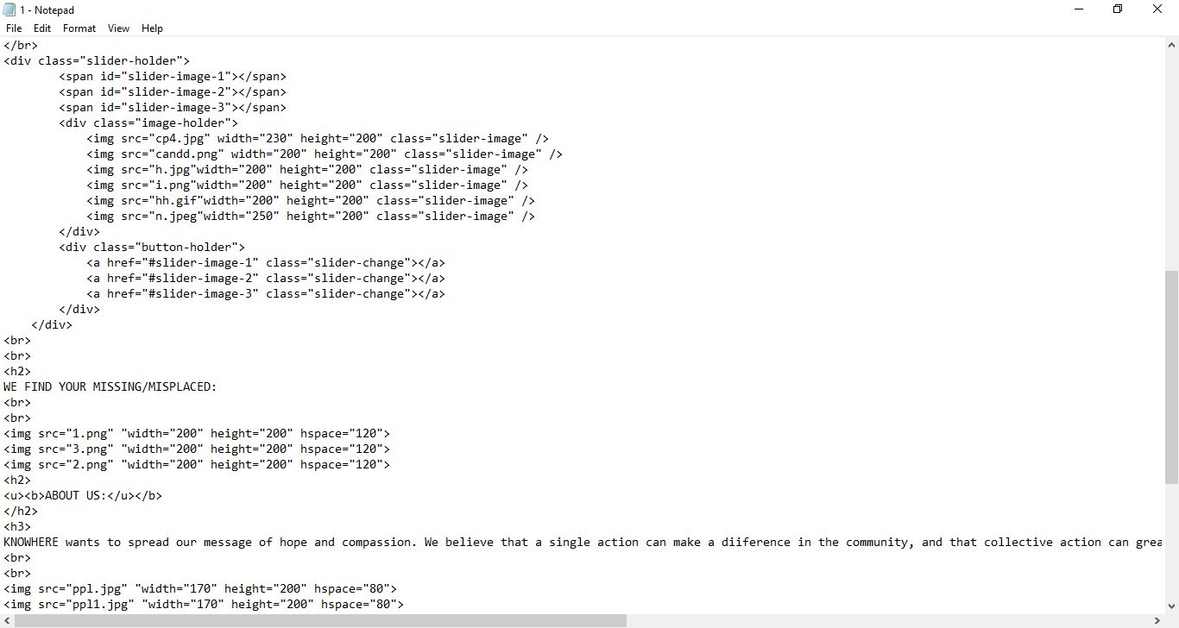

Slide 11
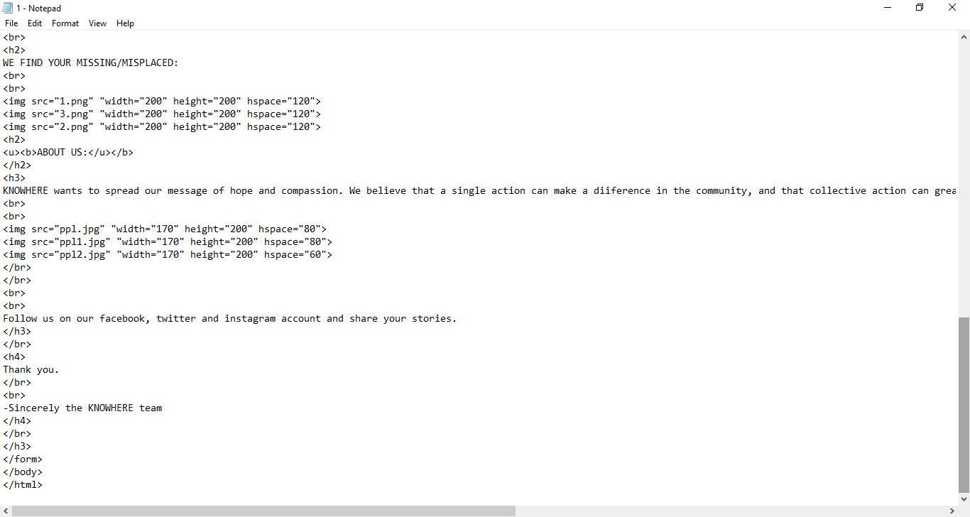

Slide 12
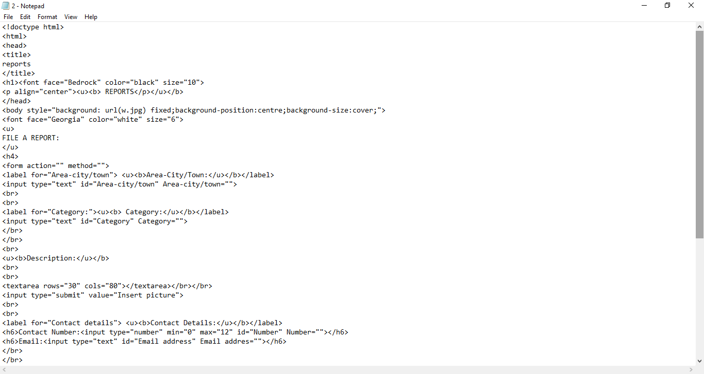

Slide 13
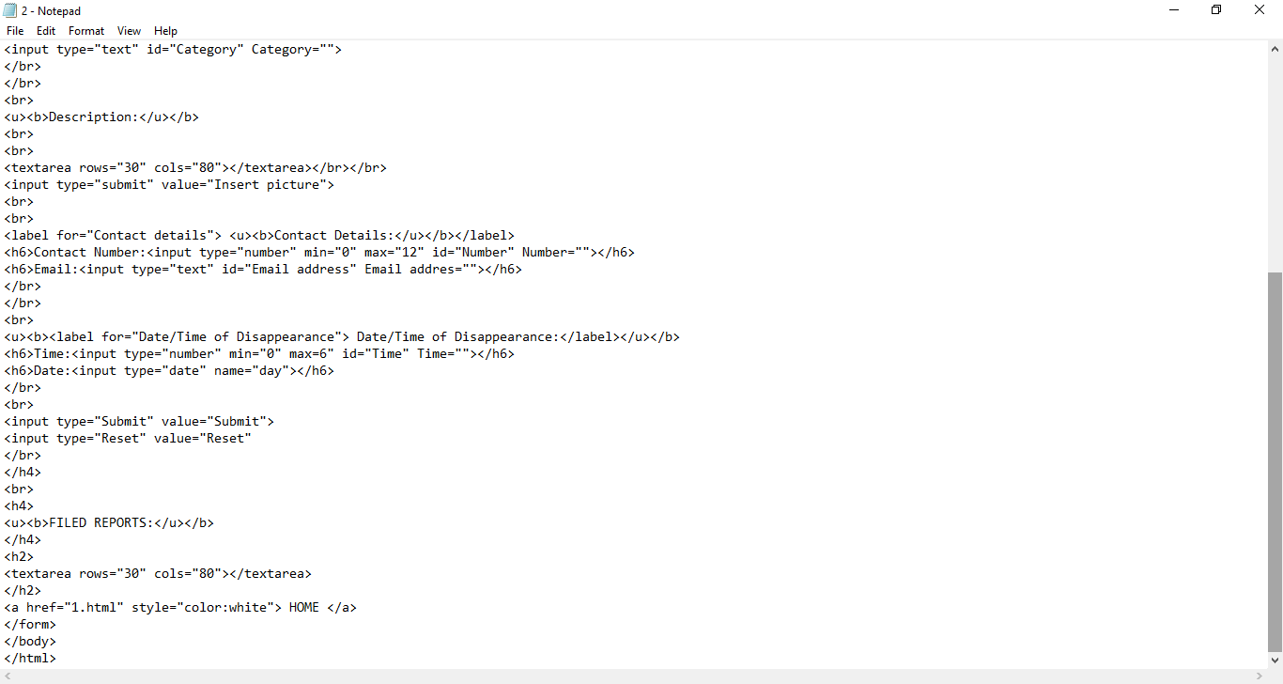

Slide 14
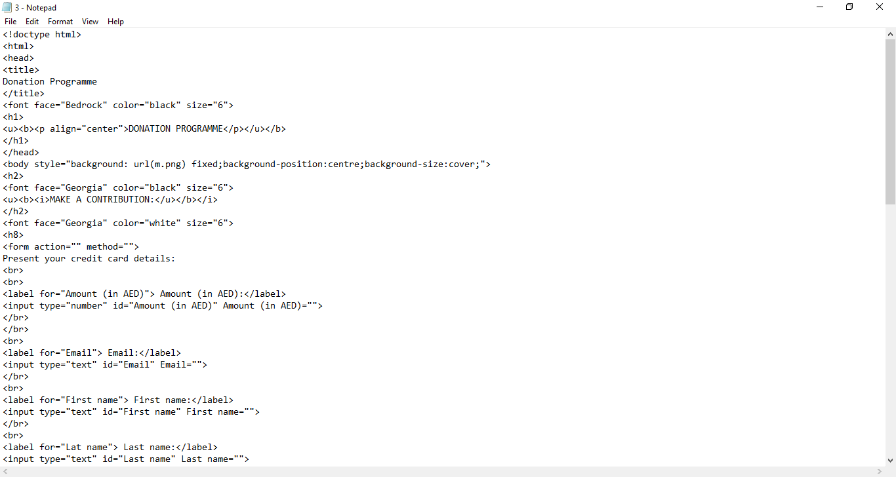

Slide 15
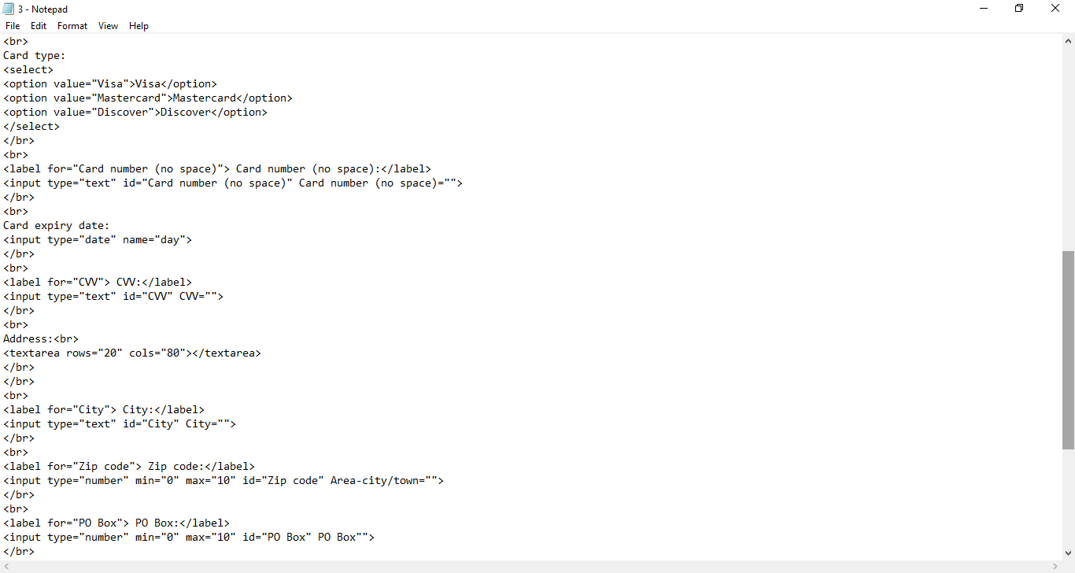

Slide 16
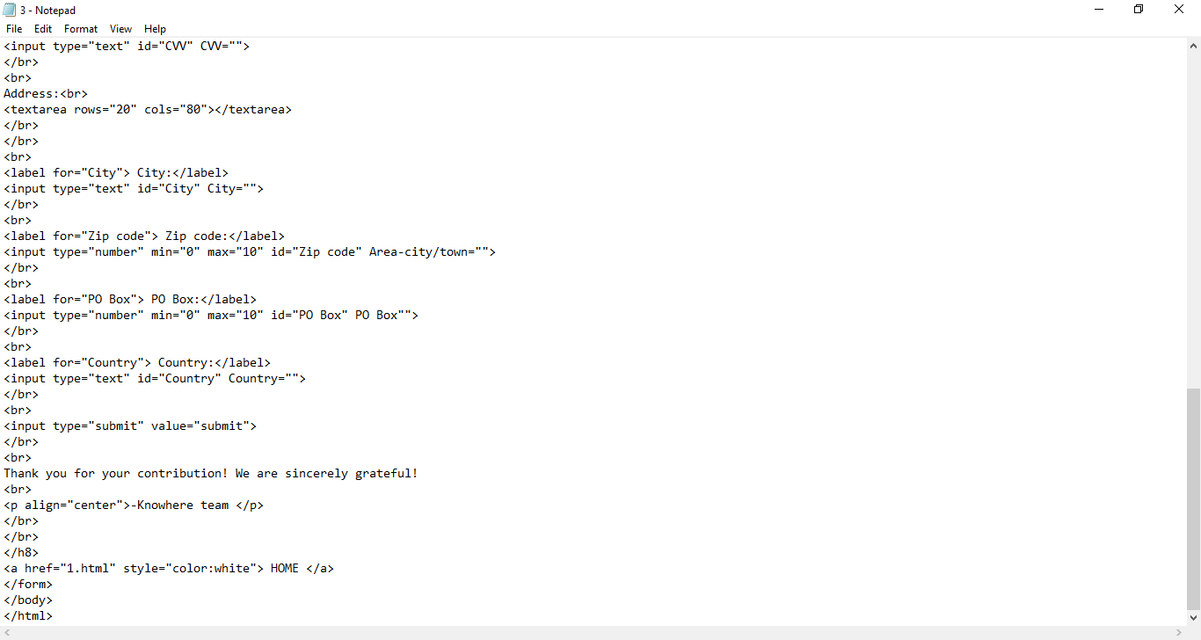

Slide 17
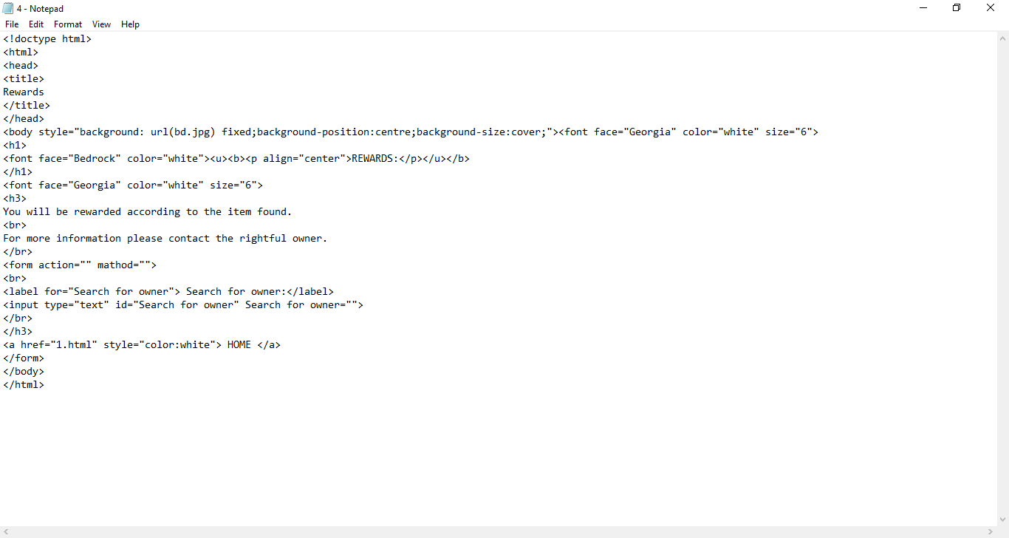

Slide 18
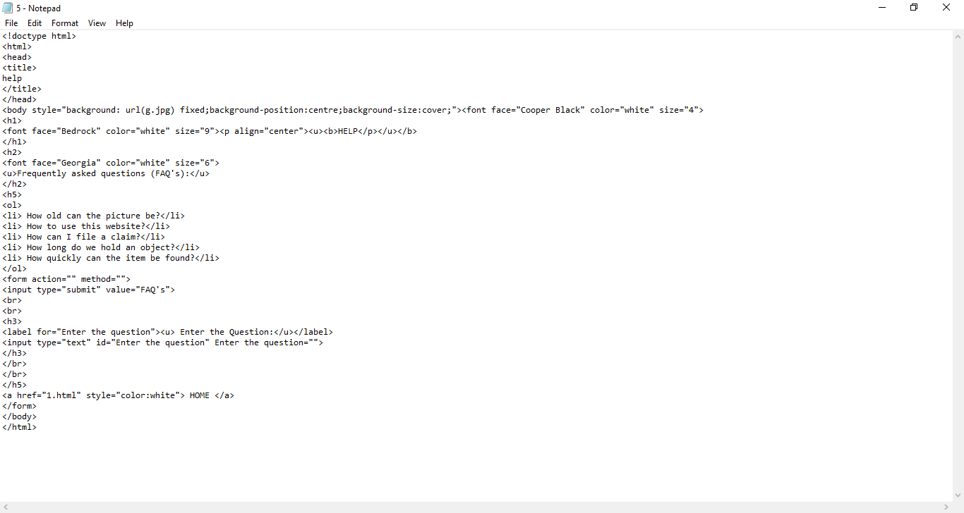

Slide 19
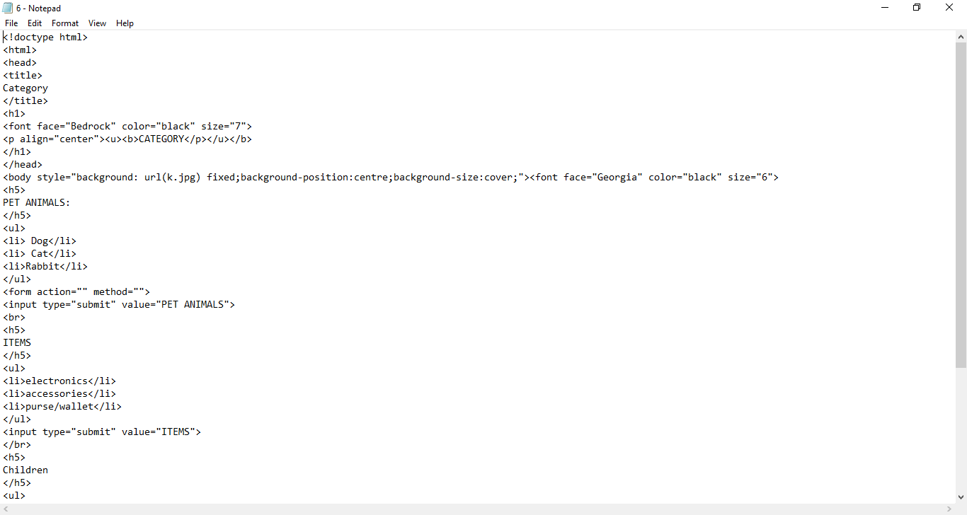

Slide 20
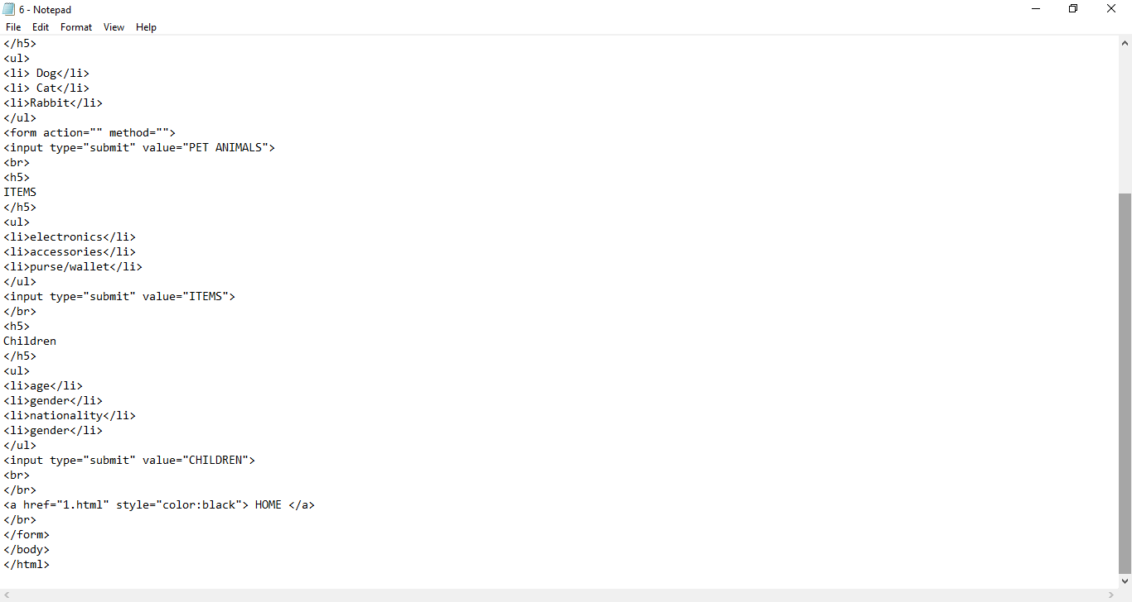

Slide 21
OUTPUT:
Produce, deliver, or supply (data).

Slide 22
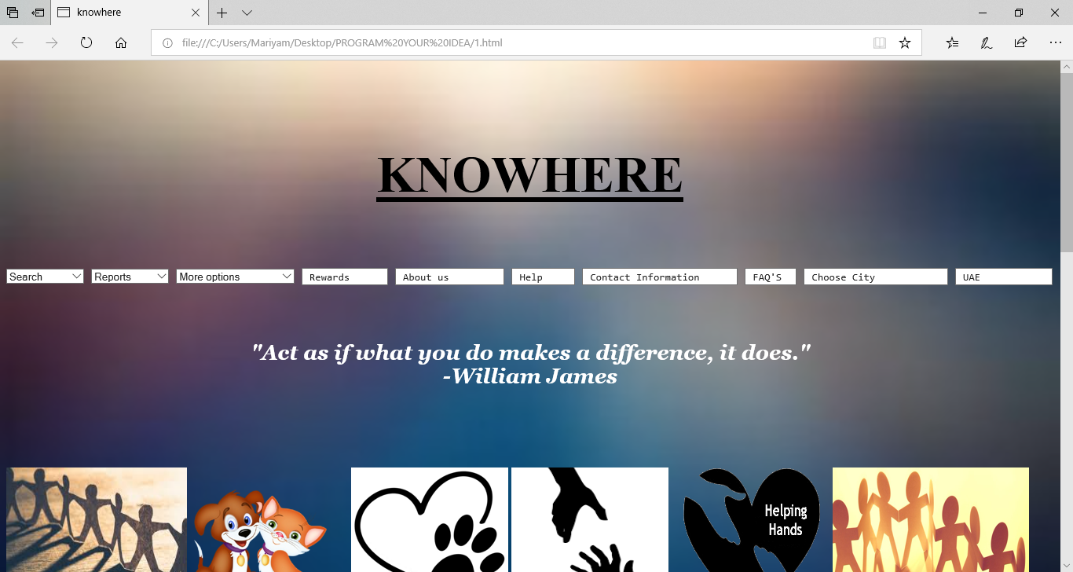

Slide 23
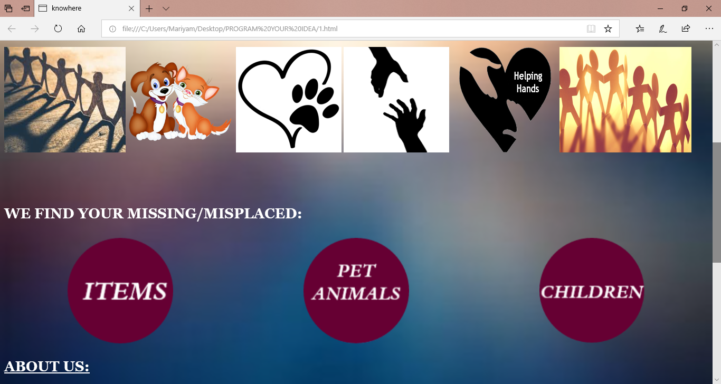

Slide 24
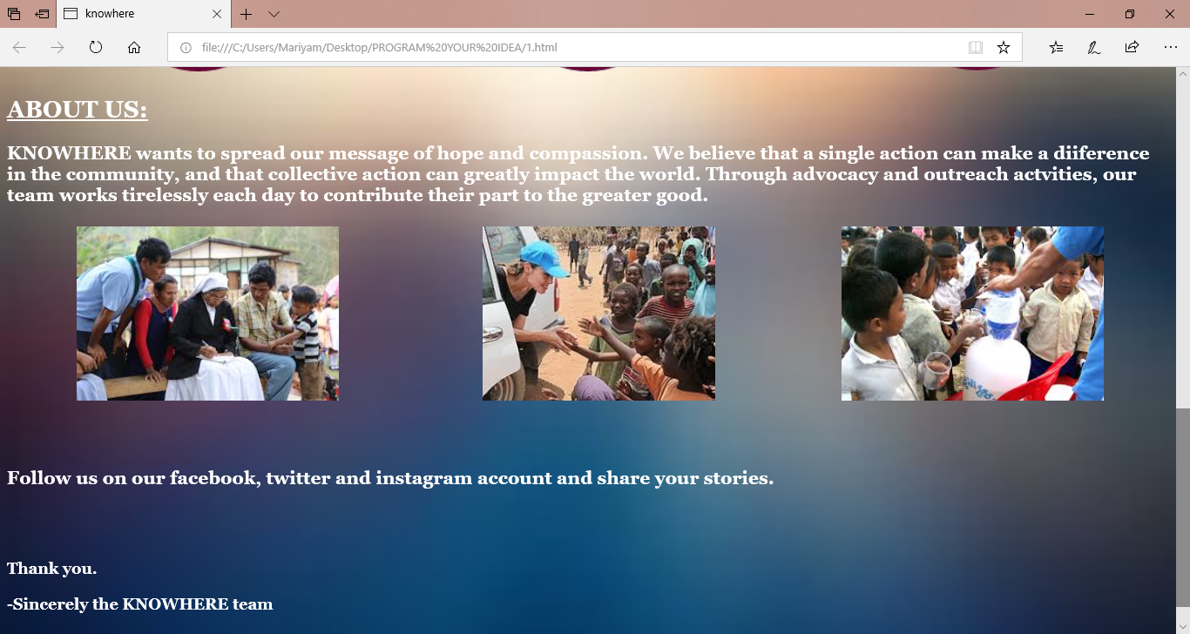

Slide 25
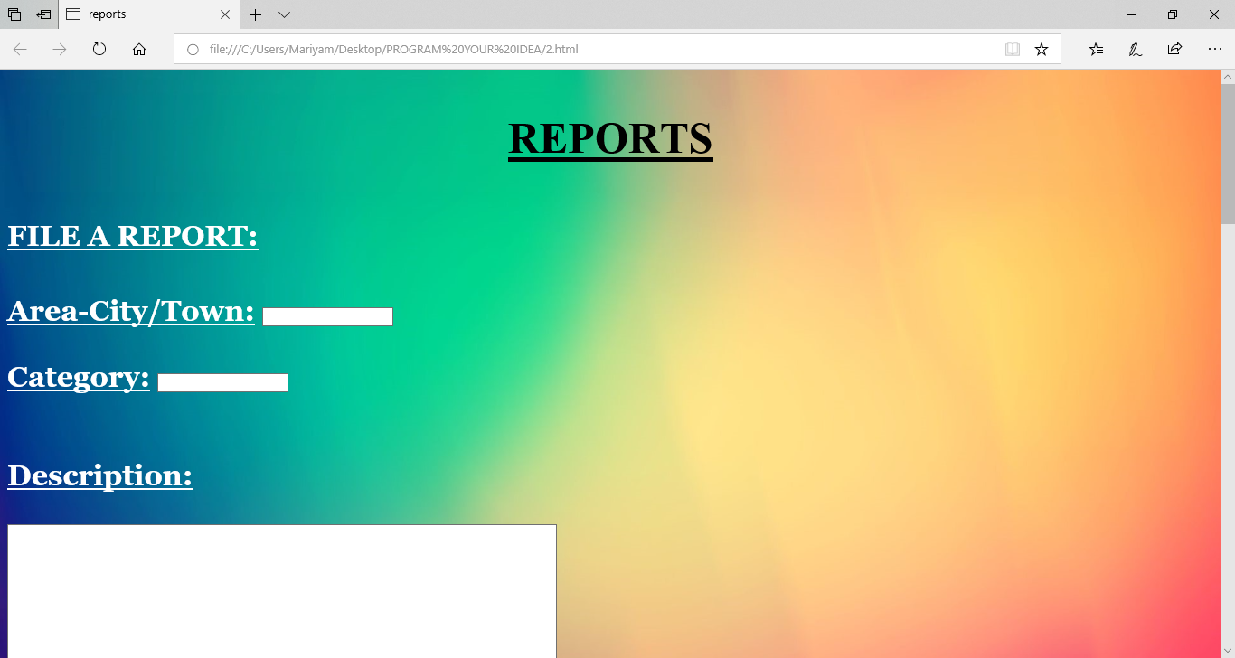

Slide 26
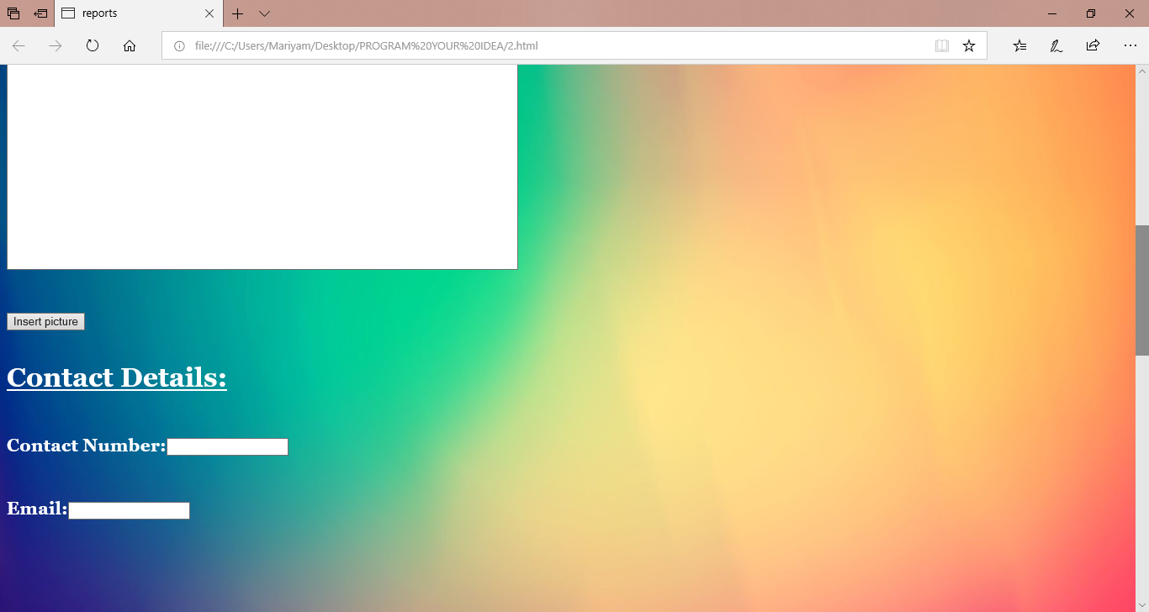

Slide 27
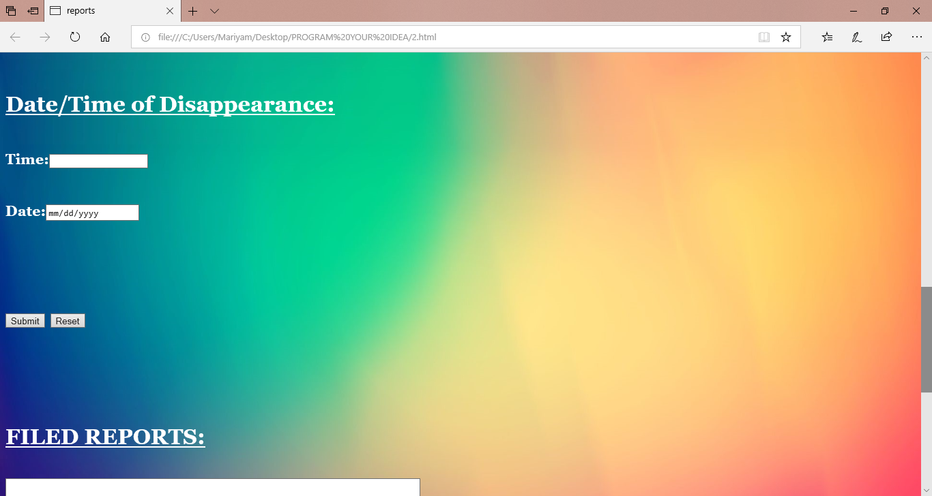

Slide 28
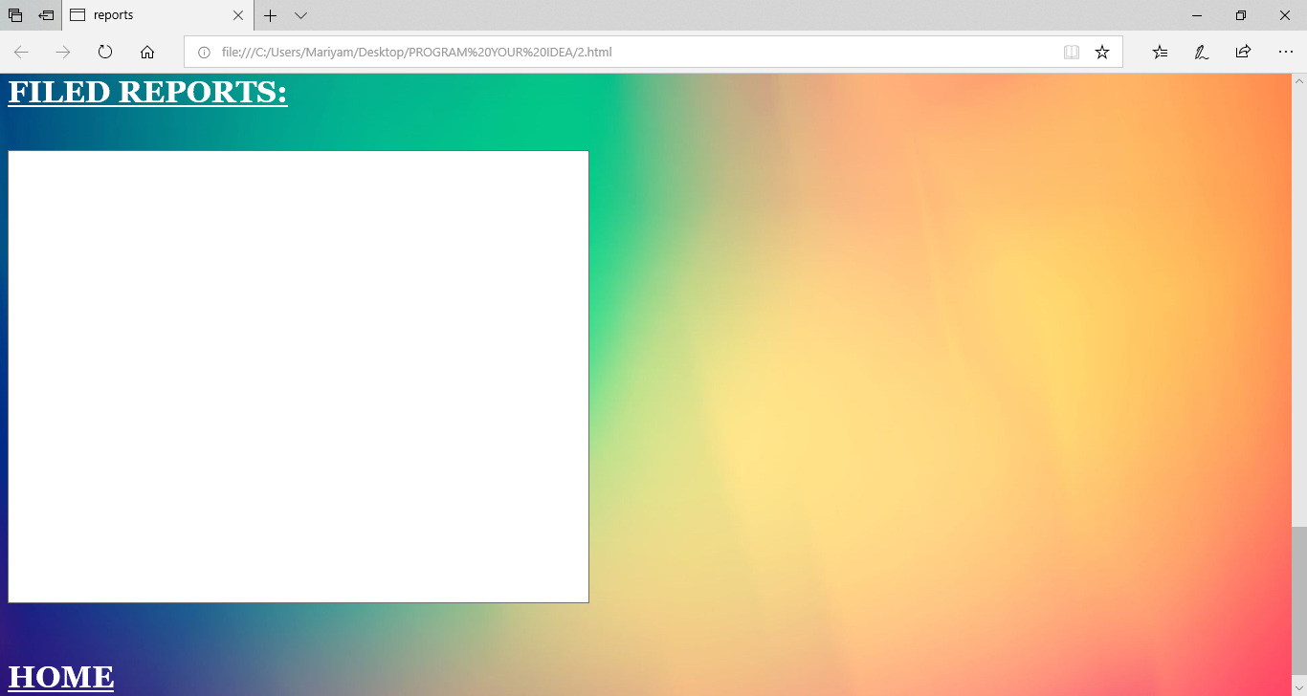

Slide 29
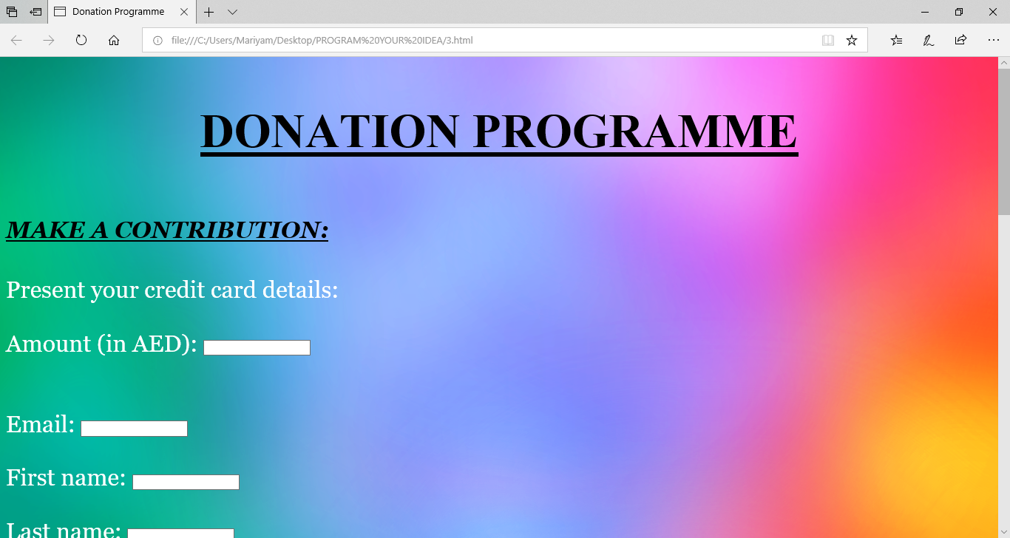

Slide 30
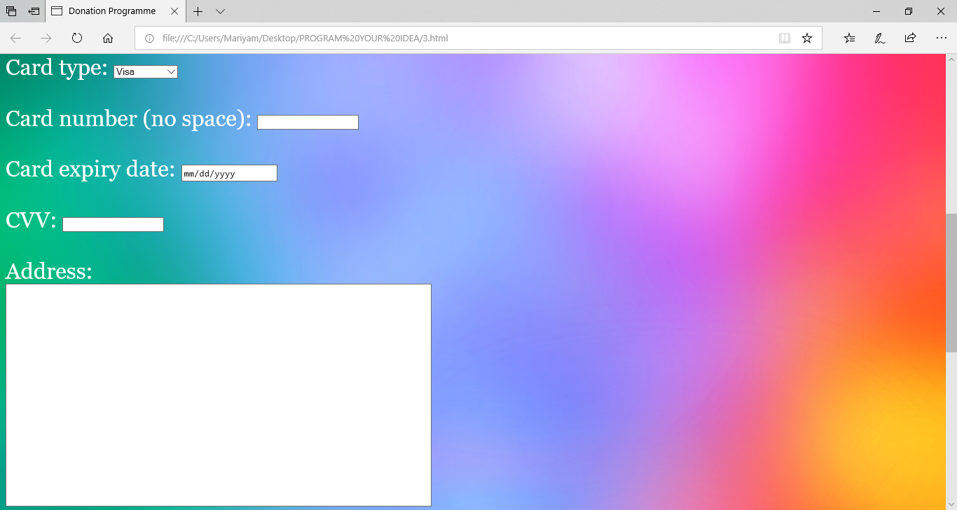

Slide 31
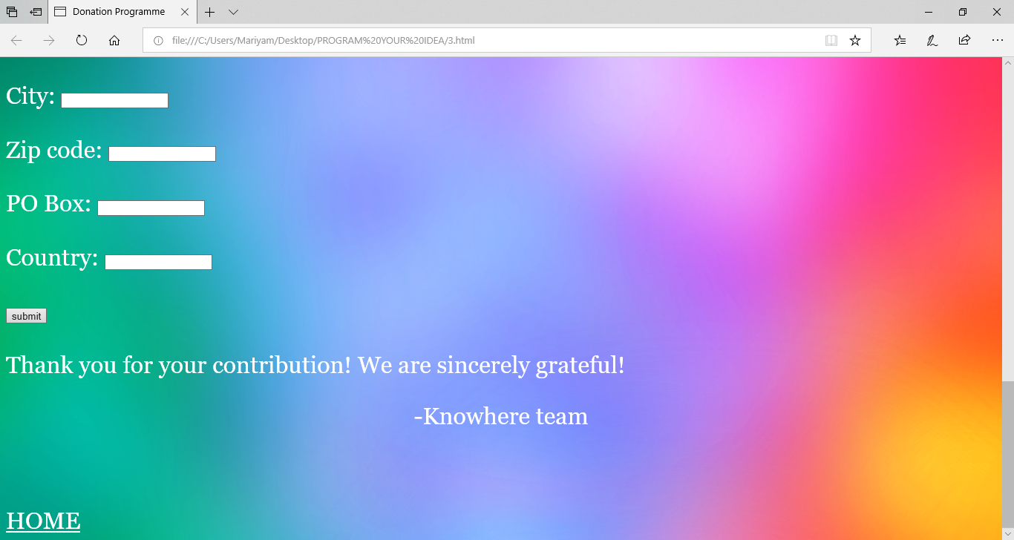

Slide 32
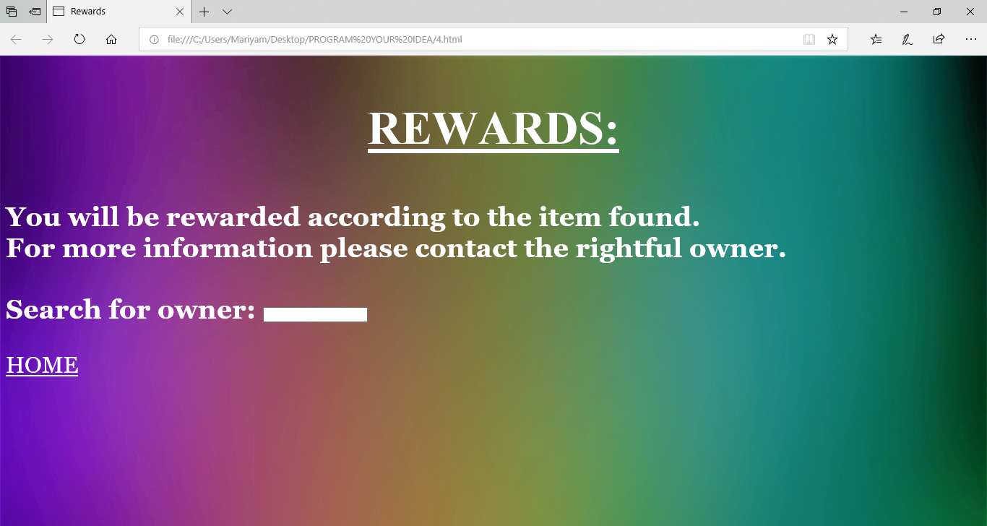

Slide 33
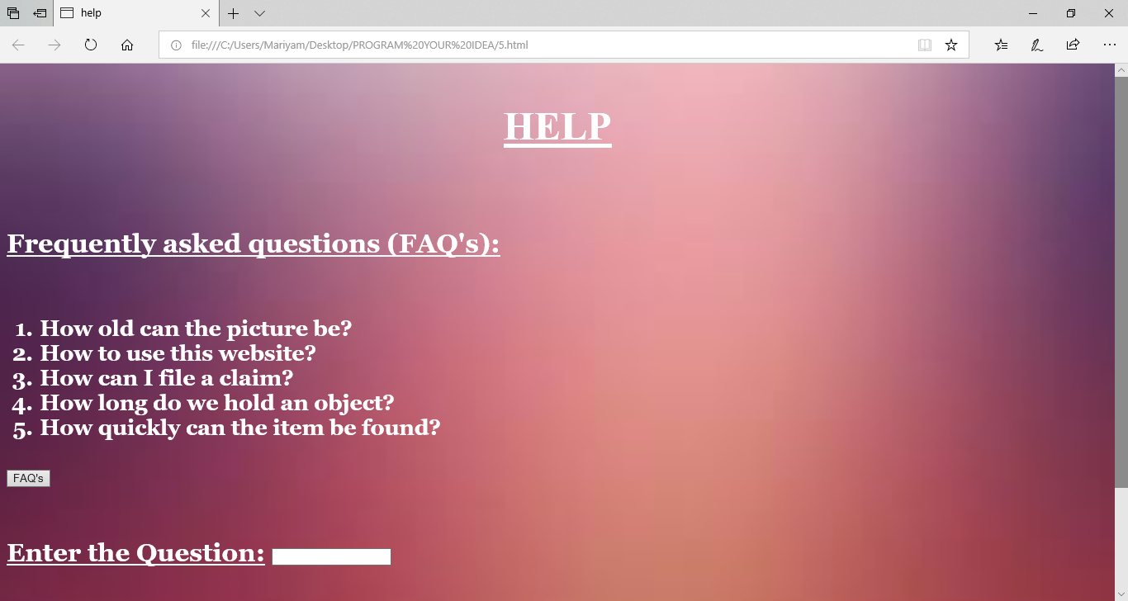

Slide 34
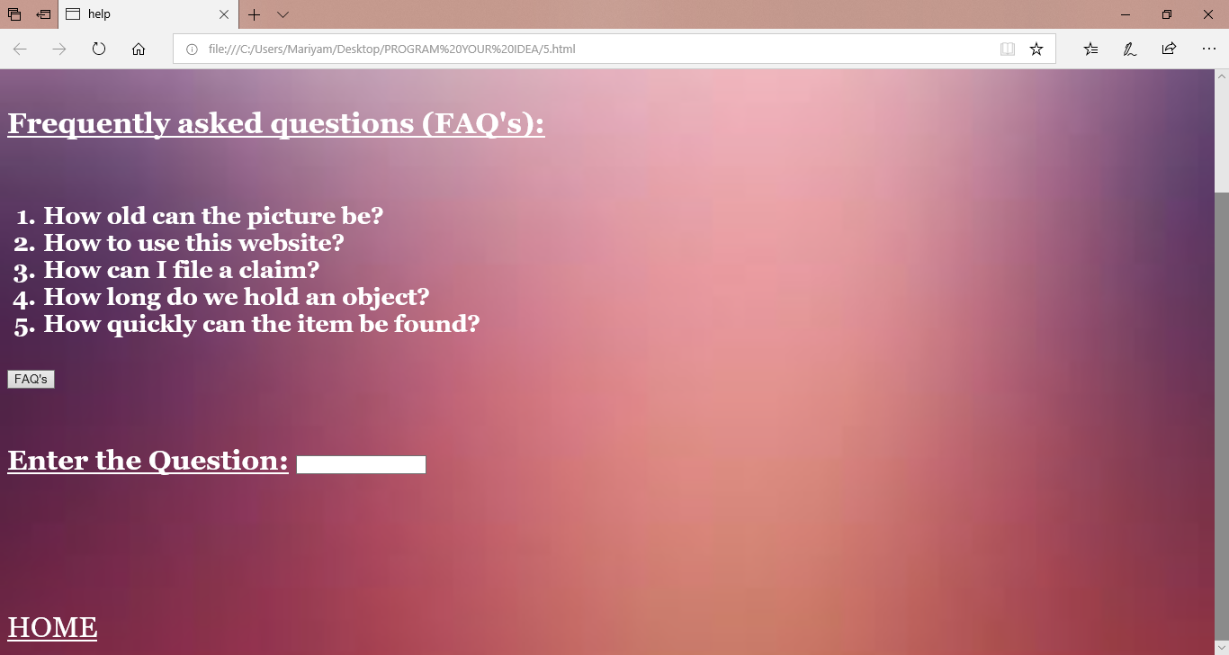

Slide 35
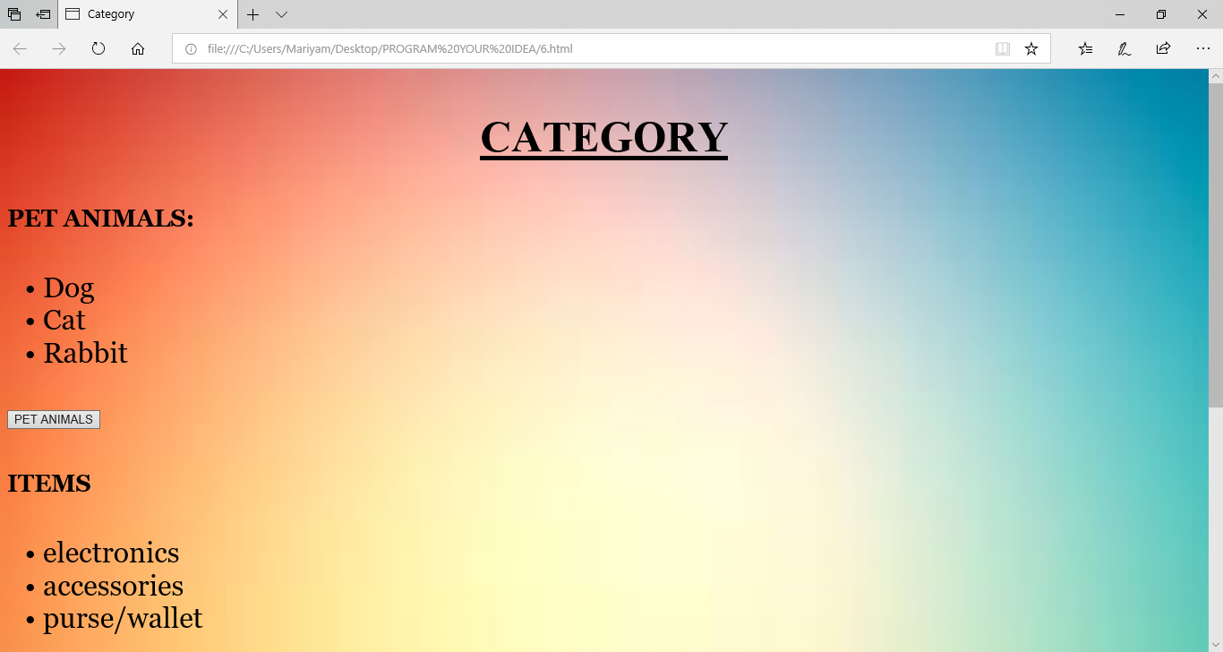

Slide 36
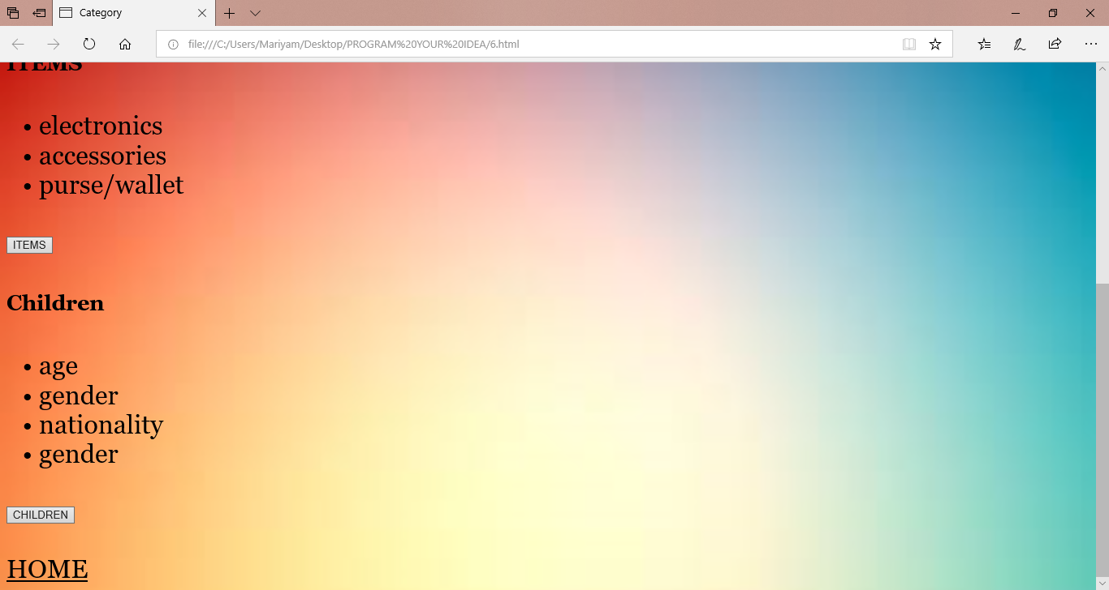

Slide 37
Conclusion:
With the help of notepad, we have successfully concluded the making of webpages which together combine to form a website.
Only with the help of the server, the users and the KNOWHERE team will this website be effective.

Slide 38
Bibliography:
YouTube channel- EJ Media
www.w3schools.com
Google images

Slide 39
Thank you
Efforts Of Mariyam Arief and Naureen Khan

